Slide 1
Firepower SDWAN
RECORD THE SESSION
Tectorial – From Zero to Hero
Bruno Fagioli
CCIE Security
10-Apr-24
Notes:
5min

Slide 2

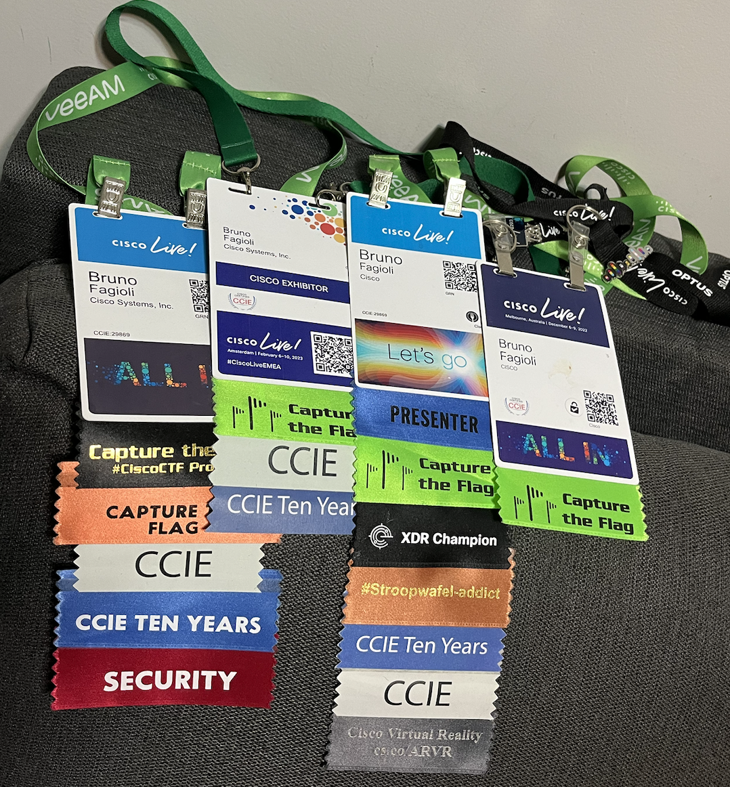
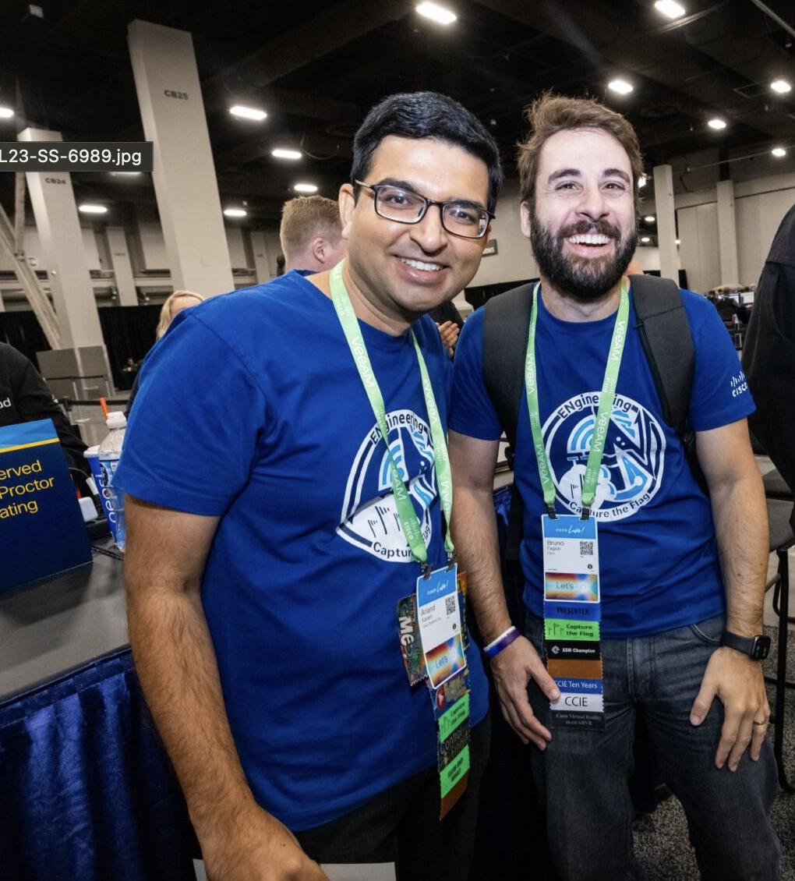

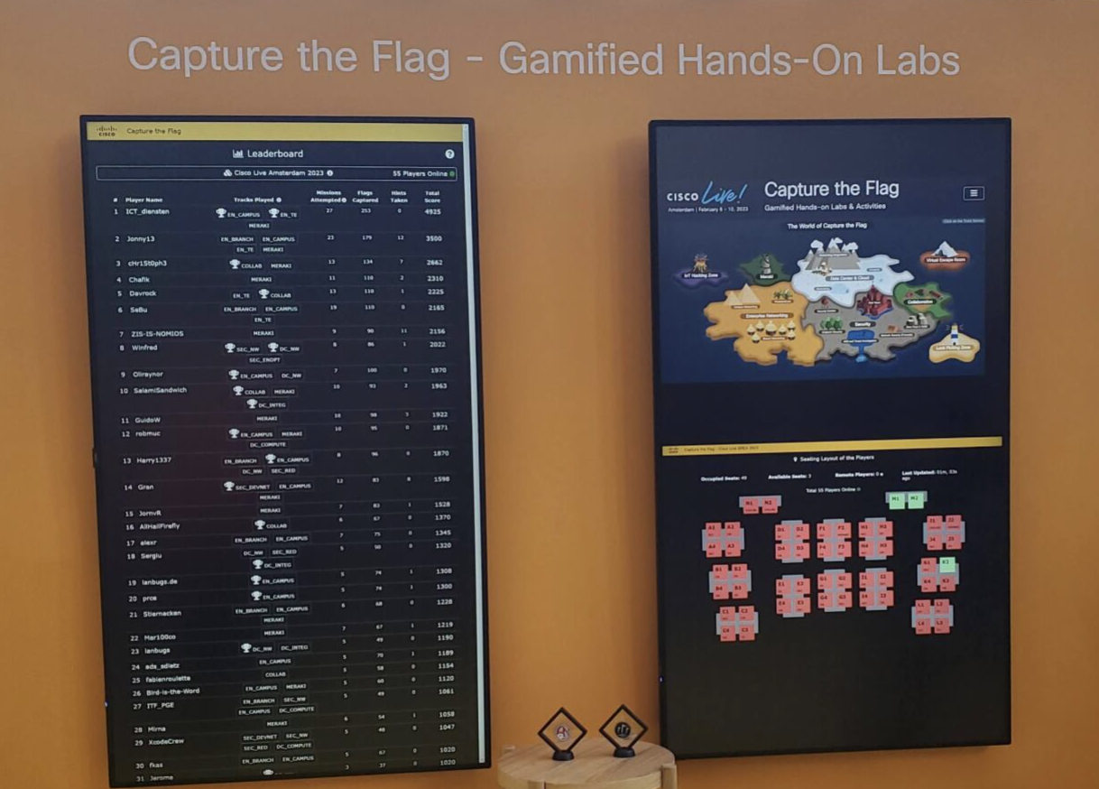





whoami
Cisco Partner Security TSA
20 anos na indústria de redes/cibersegurança
4 anos na Cisco
Líder SME em Access e Endpoint
Lider de segurança no Cisco CTF

Slide 3

Introduction
VPN Overview
Tectorial Topologies
Logical topology
Physical topology
Tectorial Lab
Interface configuration
Routing and ECMP configuration
DIA configuration
SDWAN configuration
SDWAN and WAN status

Slide 4
Introduction

Slide 5





Simplifying Branch Deployments
Secure Elastic Connectivity
Configure Route-based VPN VTI tunnels between branches (Spokes) to headquarters (Hubs)
IPv6 VTI with BGP
BGPv6 over VTI
EIGRP and OSPF over VTI
DVTI Support DHCP
High availability with near-Zero Network Down time / WAN Optimization
Dual ISP configuration
Active-Standby Backup VTI tunnel configuration with SLA Monitoring
Optimal Path Selection based on interface monitoring
Increased Usable Bandwidth
ECMP Support for load-balancing across multiple ISPs
ECMP Support for VTI
Application based load balancing using PBR
Direct Internet Access for Public Cloud and Guest Traffic
SaaS Application detection (First Packet using AVC)
DNS Snooping using trusted DNS servers
Policy Based Routing using Application as matching criteria
Local tunnel ID Support for Umbrella
Simplified Management
Data Interface Management
Auto Config Rollback
SASE: Umbrella Auto-tunnel deployment
DVTI Hub and Spoke topology simplification

Slide 6




Direct Internet Access
Routing application-based traffic directly out to the Internet rather than backhaul Device
DEPLOYMENT SCENARIO
For selective applications
For all SaaS applications
For specific users or networks or segments
BENEFITS
Faster access to cloud applications
Limit the need to back haul traffic to the data center
Accelerate your digital transformation
Internet
Applications
Physical Connection
VTI Tunnels
ECMP on VTI Interfaces
DIA Traffic
ISP1
ISP2
Internal Clients
Branch
FTD
Corporate FTD
Corporate Network

Slide 7
VPN Overview

Slide 8


Underlay & Overlay
Underlay Network
Overlay Network
Notes:
Before we go into various types of VPNs a quick recap on what is underlay and overlay. When we talk about VPNs, we often refer to an underlay and overlay network:
The underlay network is the network that is used as a transport for the VPN packets. It can be the Internet, MPLS, 4G or any other network.

Slide 9
Underlay & Overlay
VPN
Underlay Network
Overlay Network
Notes:
The overlay network is our private network that is built on top of the underlay.

Slide 10


Introducing Front Door VRFs in 7.4
Support of VRFs for VTI comes in 7.4
Greatly reduces complexity by separating route tables of underlay and overlay
Increases security by creating defined VRF boundary
No competition between VPN learned routes and underly routes
DIA use cases are supported. Creation of NAT policy creates route-leaking that is required.
EIGRP
FTD
Hub
OUTSIDE
default
INET
Outside
Default
DHCP
global
Front-Door VRF
Branch

Slide 11
What is SSE?
Notes:
5min

Slide 12

Employees are frustrated
64%
believe the way they interact with technology directly impacts morale
65%
believe they would be more productive if they had better technology
Ivanti Study

Slide 13









Market is moving to Security Service Edge
SSE is a cloud-based security service that provides safe access to Internet and private applications.
65%
plan on adopting SSE in next 2 years
SASE
Secure SD-WAN Fabric
Performance-based Internet Routing
On-prem Unified Threat Management
On-ramp into Public IaaS and Private Cloud
SD-WAN Analytics (including Internet Intelligence)
Cloud Access Security Broker (CASB)
Firewall as a Service (FWaaS)
Zero Trust Network Access (ZTNA)
Secure Web Gateway (SWG)
SD-WAN
SSE

Slide 14
Firepower SDWAN Tectorial topologies
Notes:
15min

Slide 15
Lab Logical Topology
Front-door
VRF ext
Branch1
BGP
Outside_gi3_40
198.60.62.100
NGFW1
Hub
int_10: 198.19.11.0/24
198.19.20.0/24
Outside_gi4_30
198.60.162.100
OUTSIDE 198.18.133.81
Outside_gi3_40
198.60.40.100
198.19.30.0/24
Branch2
EIGRP
In10 198.19.10.1
Internet
Outside_gi4_50
198.60.50.100
int_20: 198.60.20.0/24
198.19.40.0/24
Branch3 OSPF
Outside_20
198.60.64.100
int_30: 198.60.30.0/24
Notes:
Branch1 – Outside_40 == Giga0/3 – 198.60.62.100
Branch1 – Outside_30 == Giga0/4 – 198.60.162.100

Slide 16
Lab Logical Topology - detailed
Outside_gi3_40
198.60.62.100
Front-door
VRF ext
Branch1
Corporate2
198.19.20.0/24
FTD
Hub
Outside_gi4_30
198.60.162.100
vrf: corp2
CSR2: .62
198.19.11.0/24
Kali: .200
198.19.10.1/24
Outside_gi3_40
198.60.40.100
Branch2
198.18.133.81/19
Internet
vrf: corp3
CSR3: .63
Outside_gi4_50
198.60.50.100
198.60.20.0/24
Corporate3
198.19.30.0/24
vrf: branch2
CSR1: .61
vrf: corp4
CSR4: .64
Branch3
vrf: branch3
CSR4: .64
Corporate4
198.19.40.0/24
Outside_20
198.60.64.100
198.60.30.0/24
Notes:
Branch2 – Outside_gi3_30 – address 40
Branch2 – Outside_gi4_40 – address 50

Slide 17
SDWAN Topology
Outside_gi3_40
198.60.62.100
Front-door
VRF ext
Branch1
Corporate2
198.19.20.0/24
Default BGP
Outside_gi4_30
198.60.162.100
FTD
Hub
BGP 198.19.11.0/24
vrf: corp2
CSR2: .62
198.19.11.0/24
Kali: .200
198.19.10.1/24
Internet
Via EIGRP 198.19.30.0/24
Outside_gi3_40
198.60.40.100
Branch2
198.18.133.81/19
Via EIGRP 198.60.20.0/24
vrf: corp3
CSR3: .63
Outside_gi4_50
198.60.50.100
198.60.20.0/24
Corporate3
198.19.30.0/24
Via OSPF 198.19.40.0/24
vrf: branch2
CSR1: .61
Via OSPF 198.60.30.0/24
vrf: corp4
CSR4: .64
Branch3
vrf: branch3
CSR4: .64
Corporate4
198.19.40.0/24
Outside_20
198.60.64.100
198.60.30.0/24

Slide 18
Lab Physical Topology
.1
198.60.62.0/24
.100
.62
Front-door
VRF ext
Branch1
Corporate2
198.19.20.0/24
.1
198.60.162.0/24
.100
Transit
198.19.12.0/24
FTD
Hub
CSR2
.100
vrf: corp2
CSR2: .62
CSR
.60
198.19.11.0/24
.60
PC: .200
.1
198.19.10.0/24
.1
198.60.40.0/24
.100
Branch2
.133.81
.133.60
.1
198.60.50.0/24
.100
198.18.128.0/19
198.60.20.0/24
vrf: corp3
CSR3: .63
.60
vrf: branch2
CSR1: .61
Transit
198.19.12.0/24
Corporate3
198.19.30.0/24
Branch3
vrf: branch3
CSR4: .64
vrf: corp4
CSR4: .64
.64
.1
198.60.64.0/24
Corporate4
198.19.40.0/24
.100
CSR4
198.60.30.0/24
Notes:
Branch1 – Outside_40 == Giga0/3 – 198.60.62.100
Branch1 – Outside_30 == Giga0/4 – 198.60.162.100

Slide 19
Tectorial files http://cs.co/9005nw2O5
Notes:
15min

